Slide 1
Pebble JS Dev.
Developing pebble watch face and watch apps

Slide 2
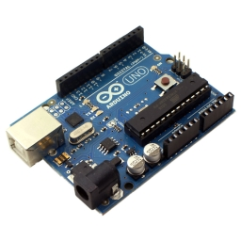
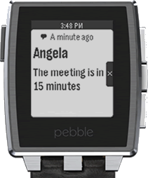
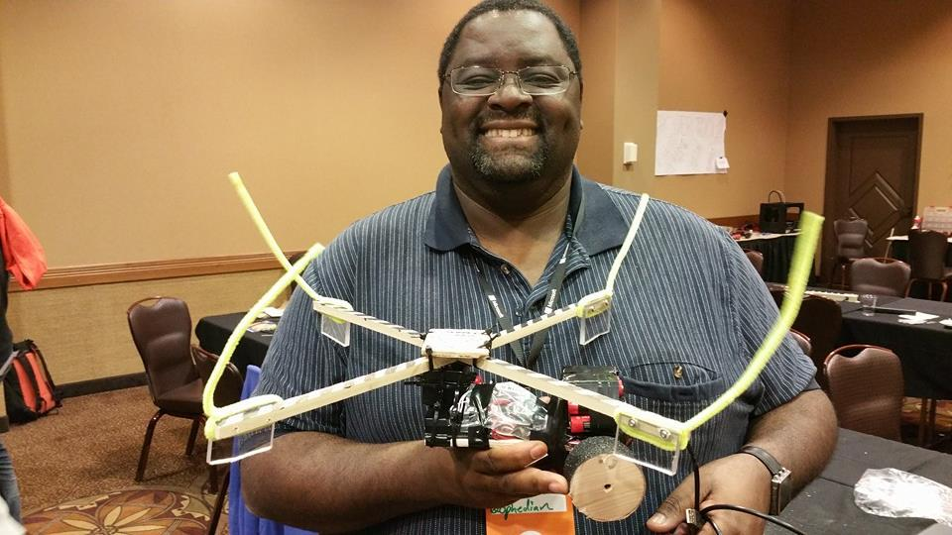
Abbey Gwayambadde
I dare you to say it fast 5 times
var i = {Husband, Dad, Presenter};
i.apply([Tall, Dark, Handsome, Geek]);
$(Philomath).on(Life, Tech, Dev);
Twitter:
@ophedian:
Skype:
AbbeyLG:
Email:
ophedian@gmail.com:
Git:
https://github.com/ophedian
Notes:
CodeMash Conference, Arduino, Pebble Watch

Slide 3
Presentation Audience
Knows
JavaScript
HTML concepts (DIV, CSS Styling, etc.)
Familiar with the following technologies
Wearables (Pebble, Samsung Gear, LG Watches, etc)
Current UI Trends
Using Third Party libraries
Using JSON Restful Services
Notes:
Who is this presentation for?

Slide 4
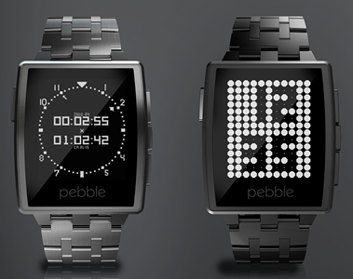
What can the Pebble do for you
What the Pebble
#1 Selling Watch, over 1 Million sold
Supports Android Wear
Works on Android AND iOS
Program in C or JavaScript
Current Applications
Watch Faces
Watch Applications
Notifications
Android Wear Support
Control Phone Apps
Custom Apps growing
Breaking News !!
WebOS team joins Pebble
Pebble redesign
Pebble color edition?

Slide 5
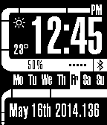
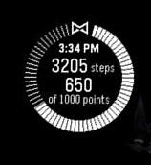

Watch Face Apps
Pros
Great for time dependent applications
Made to be visible all the time
Summary display for Phone Apps
Cons
Limited interaction (shakes, Taps)
Efficient code as it runs all the time

Slide 6
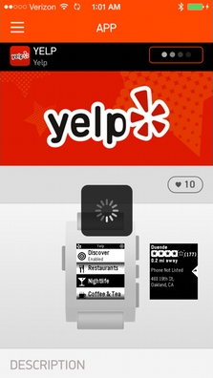
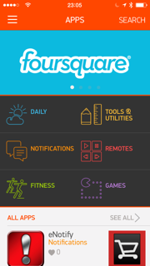
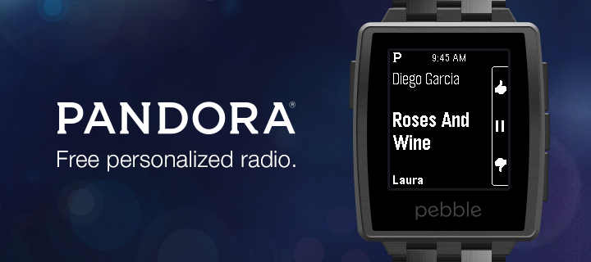
Watch Apps
Pros
The sky is the limit
Can store and retrieve data
Can message with Phone Apps
Can have a heavier memory print
Sandboxed
Cons
More difficult to write
Useful only when started
Must be able to recall state
On suspend, resume
No background processes

Slide 7
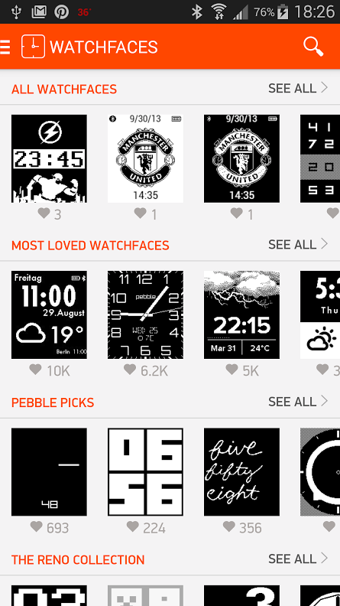
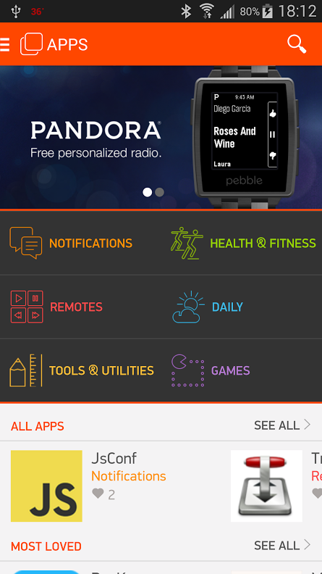
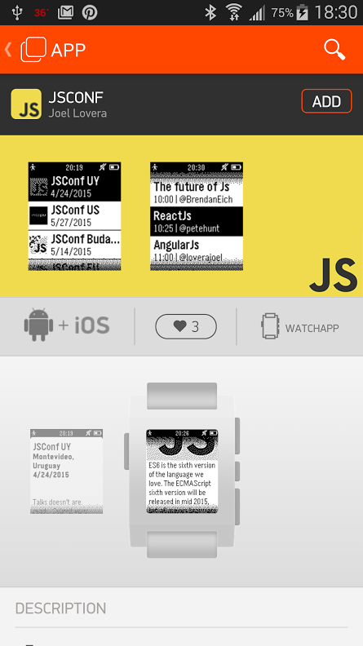
Pebble App Store

Slide 8
So what do I have to work with
UI
Pebble { Black and white: 144 × 168 pixels, 176 PPI}
Pebble Time { Color: {144 × 168 pixels, 182 PPI}
Sensors
Bluetooth: 2.1 (default). 4.0 + EDR (iOS 7+ uses LE for notifications)
E-Compass: Version 2.5 plus only
Ambient Light Sensor: Always set to auto
Microphone: Pebble Time only
Power Usage
CPU: 70%, Bluetoth, 27%, LCD [ Pebble: 1.2, Time: 4%], Sensors/lighting: 1.8
AppInfo.json
"type": "png", "name": “Unique_Identifier_here", "file": "images/your_image.png"

Slide 9
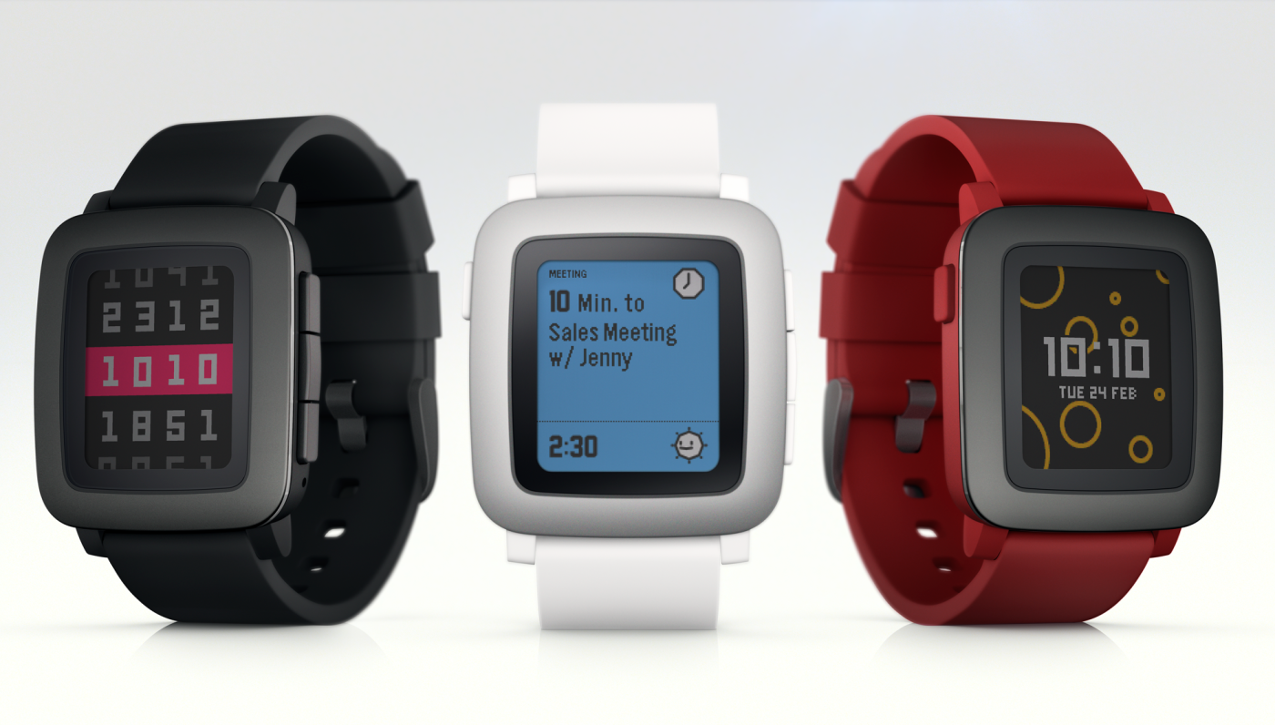
Pebble Time
What is New!!
Time line concept
Pin it
Tokens
User/Application unique
Notifications
Token
Topic
All

Slide 10
Lets View some Code
File System Development
Appinfo.json : capabilities: [“configurable”]
Under settings in Cloud Pebble
js/pebble-js-app.js
File automatically loaded by Pebble for the app
Add your application to the store
https://dev-portal.getpebble.com
Cloud Pebble Development
Cloud Pebble Development
“ready” = JavaScript handler is ready
“appmessage” = when you have received a message from phone
Pebble.sendAppMessage(message) – to send to phone

Slide 11
Resources
Code/Slides
https://github.com/ophed
Pebble Resources
Cloud Dev: https://cloudpebble.net/ide/
PebbleJS: http://developer.getpebble.com/docs/pebblejs/
SimplyJs.io: http://simplyjs.io/
Store Submission: https://dev-portal.getpebble.com/
Inspiration
SetPebble: http://setpebble.com/

